Slide 1
Assignment 5 & 6:
Charts
DSC640-T301 Data Presentation and Visualization
Date:1/12/2023
By: Joshua Greenert

Slide 2
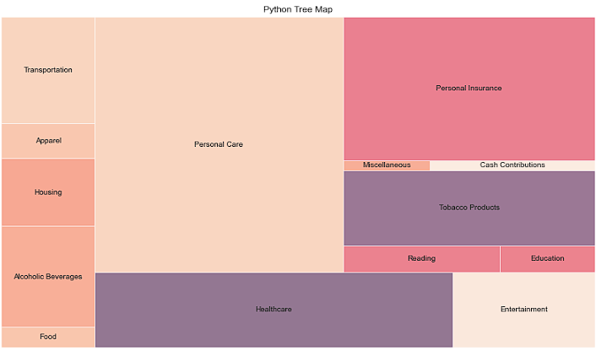
Python Charts
Notes:
Expenditures

Slide 3
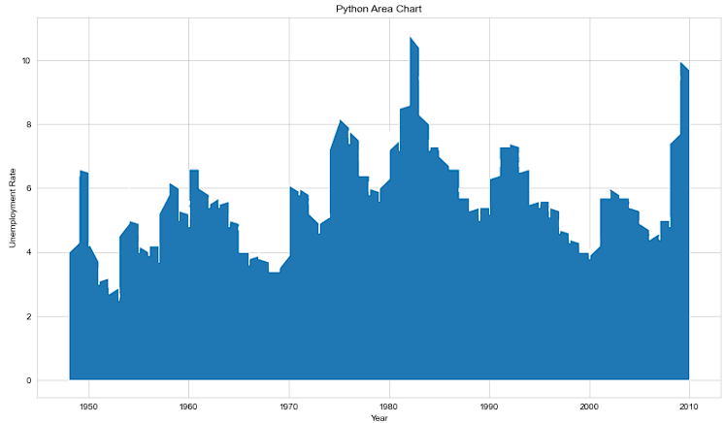
Python Charts
Notes:
Unemployment

Slide 4
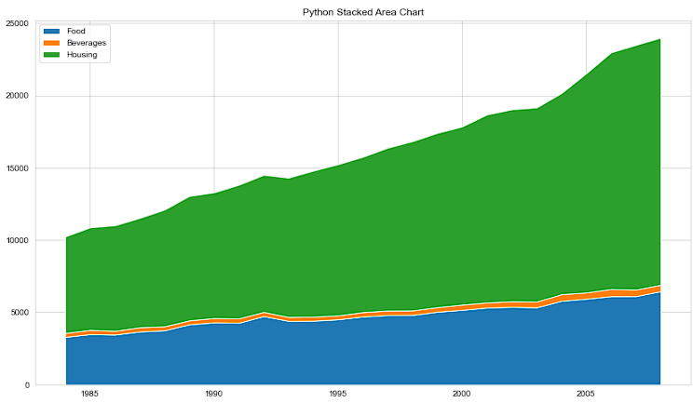
Python Charts
Notes:
Expenditures

Slide 5
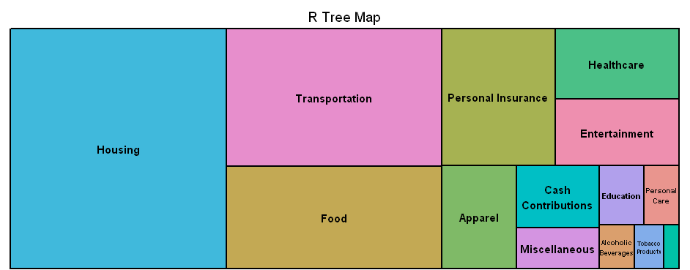
R Charts
Notes:
Expenditures

Slide 6
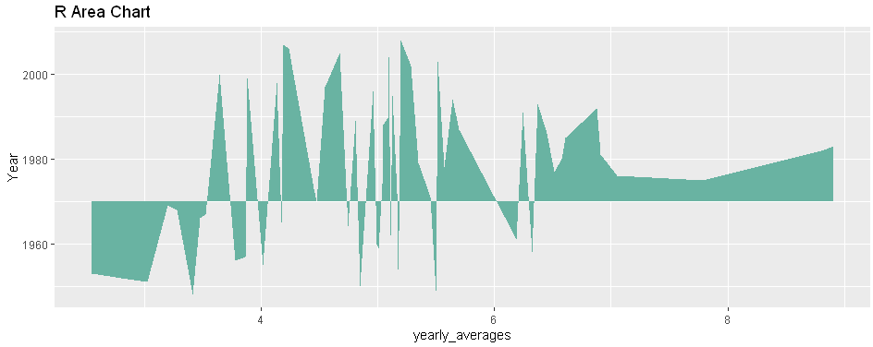
R Charts
Notes:
Unemployment

Slide 7
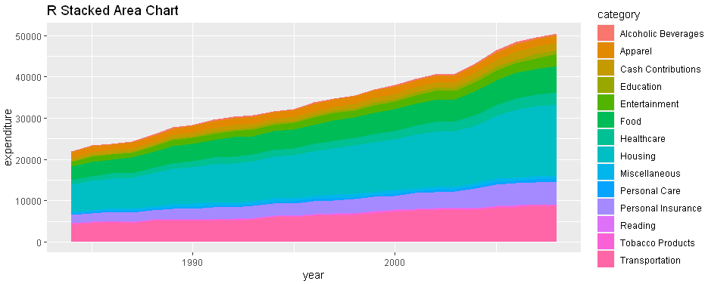
R Charts
Notes:
Expenditures

Slide 8
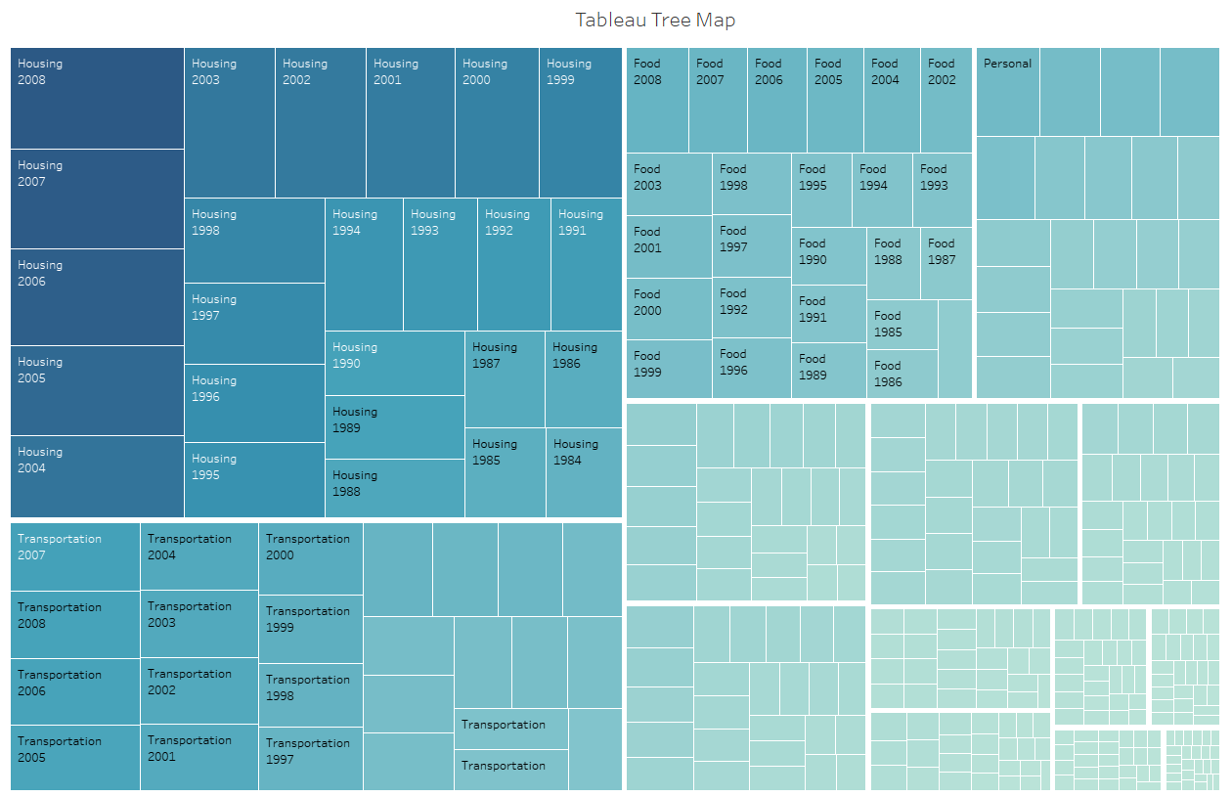
Tableau Charts
Notes:
Expenditures

Slide 9
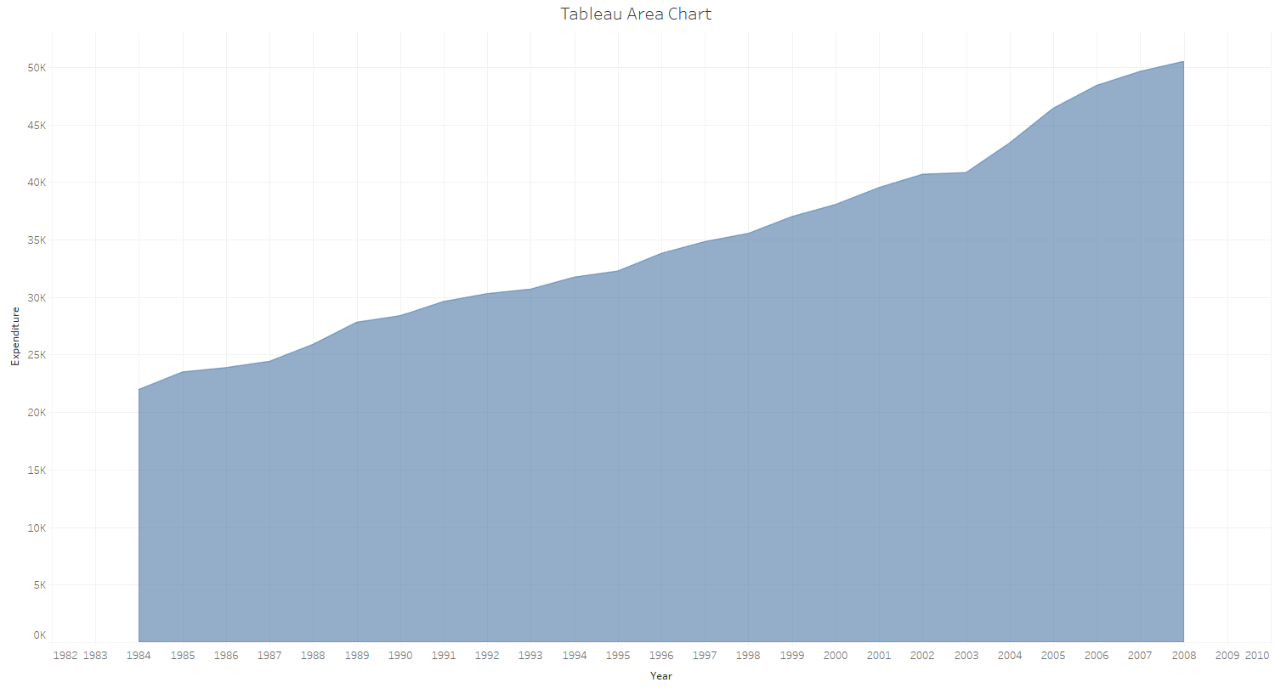
Tableau Charts
Notes:
Expenditures

Slide 10
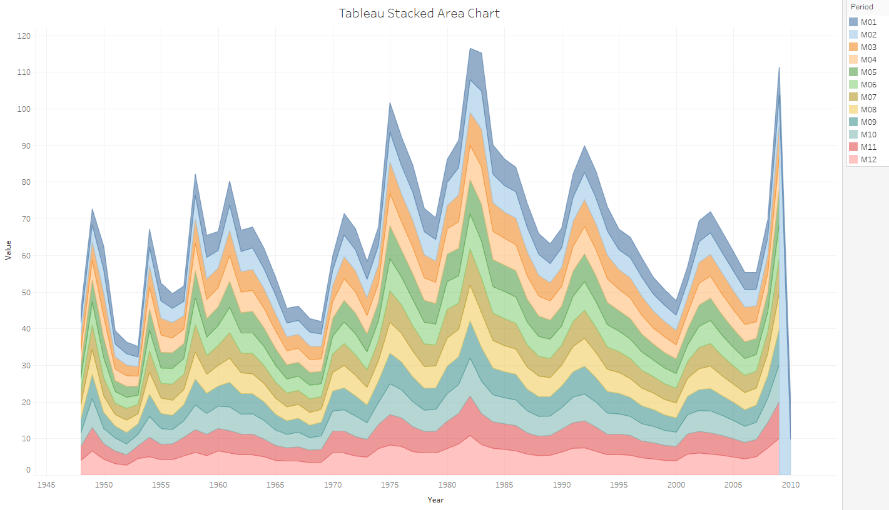
Tableau Charts
Notes:
Unemployment

